Slide 1
Service Learning EDEN FOODS WEB APP
Team Members
Alina Shaji – 2362025 Austin Sajeev Abraham (2362046) Bhuvnesh B Erambath (2362053) Christy Samuel Moses Dsouza (2362056)
Rishabh M Malge (2362195)

Slide 2
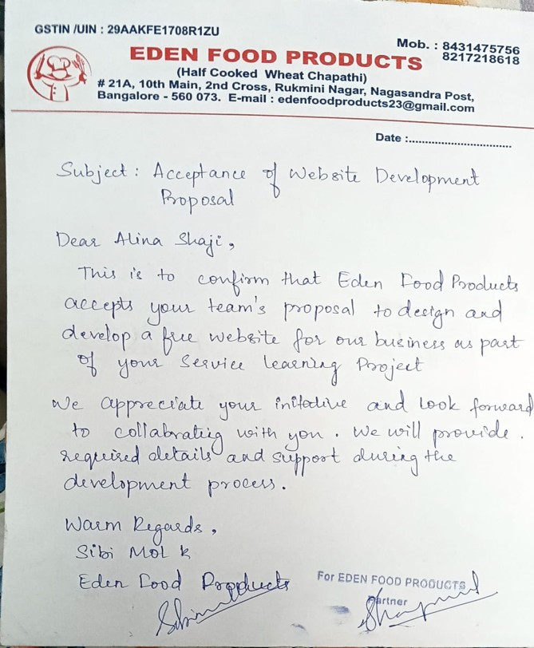
CONFIRMATION LETTER

Slide 3
NEED ANALYSIS
Visibility & Branding
Customers need an easy place to learn about the company, the founders (women entrepreneurs), and product range.
Sales Channel
Local customers want to place orders online for pickup/delivery — the website enables direct orders and reduces dependence on phone orders.
Trust & Legitimacy
An official site + company letterhead + geotag photos increases trust for B2B and retail buyers.
Product Catalog & Information
Customers need clear product descriptions, prices, and images to choose items.
Payments & Convenience
Integrating Razorpay provides secure, easy payments and enables pre-paid orders.
Operational Efficiency
An admin panel helps the company manage orders, update product availability, and view order history.
Marketing & Growth
A website enables SEO, social sharing, and future integration with local marketplaces or delivery apps.

Slide 4
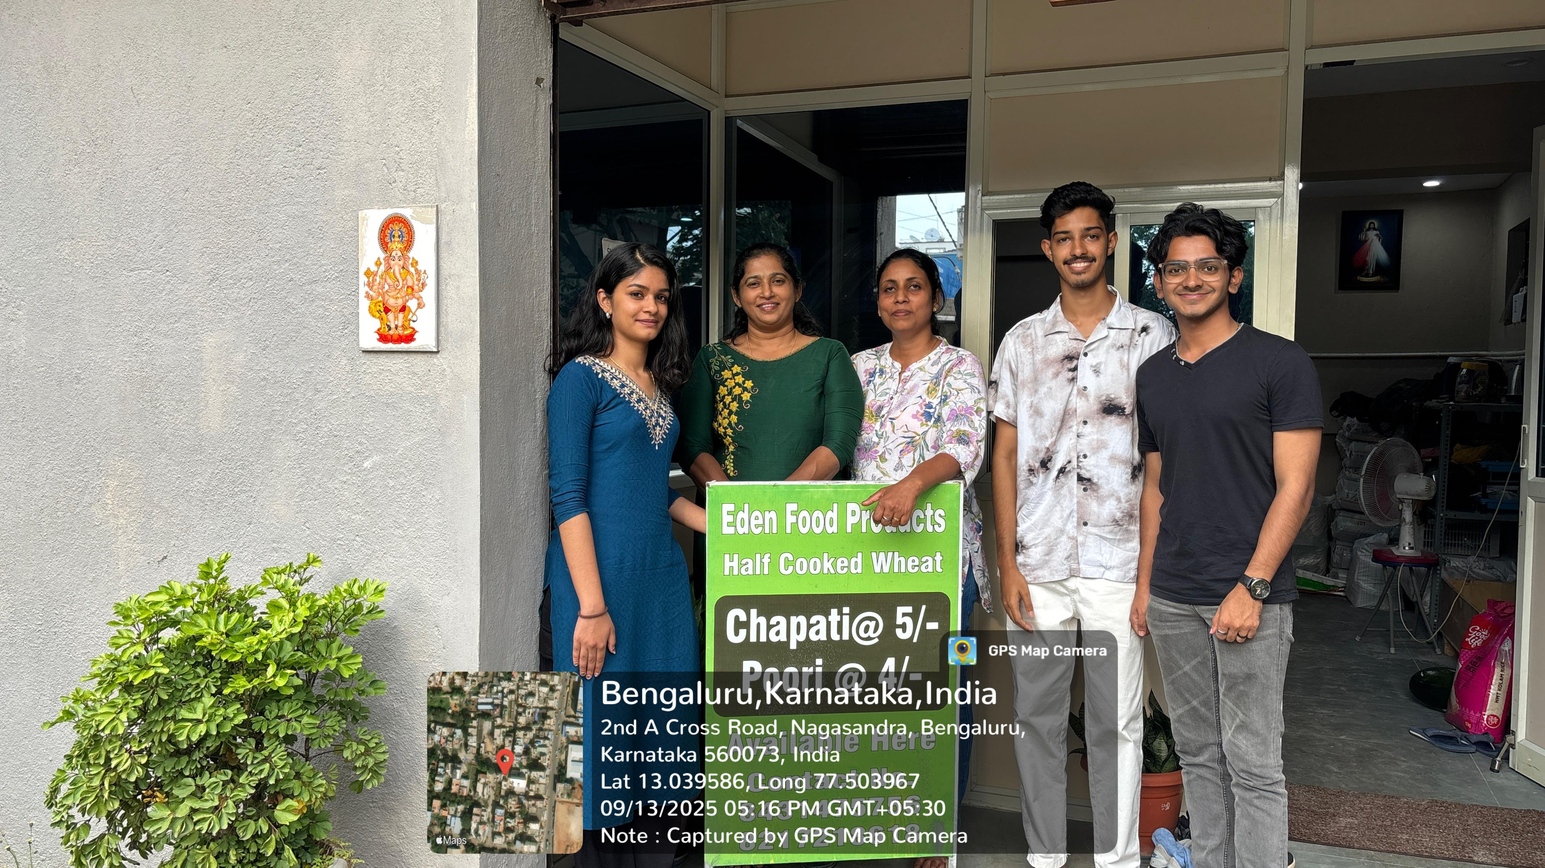
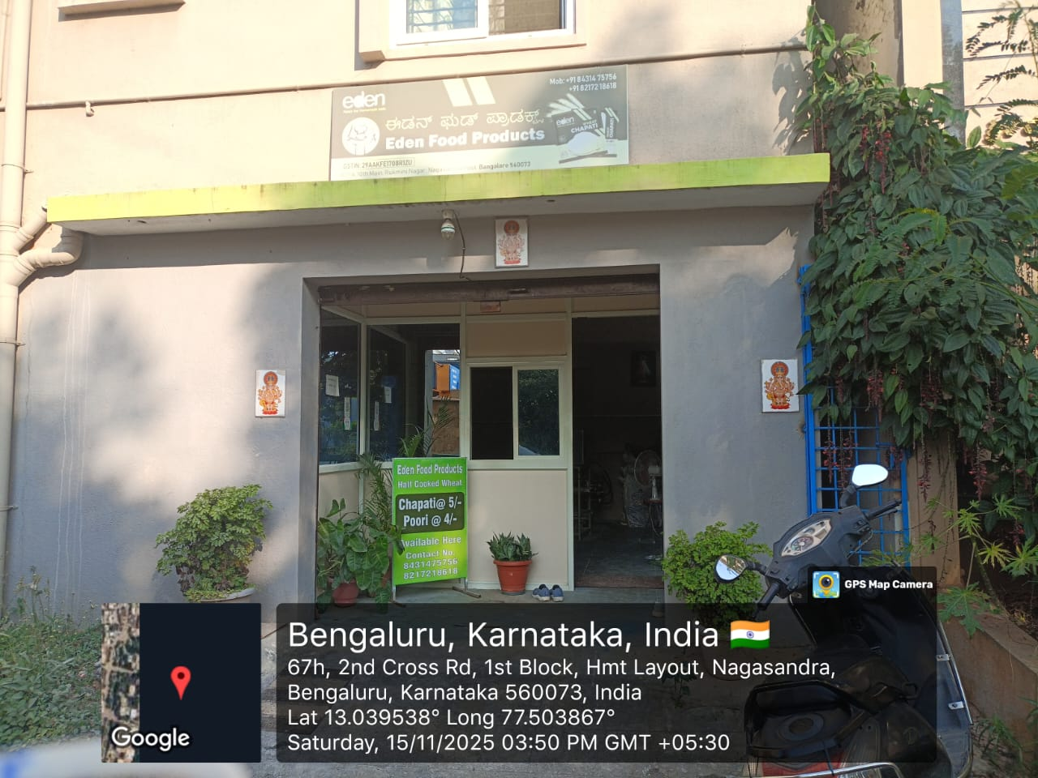
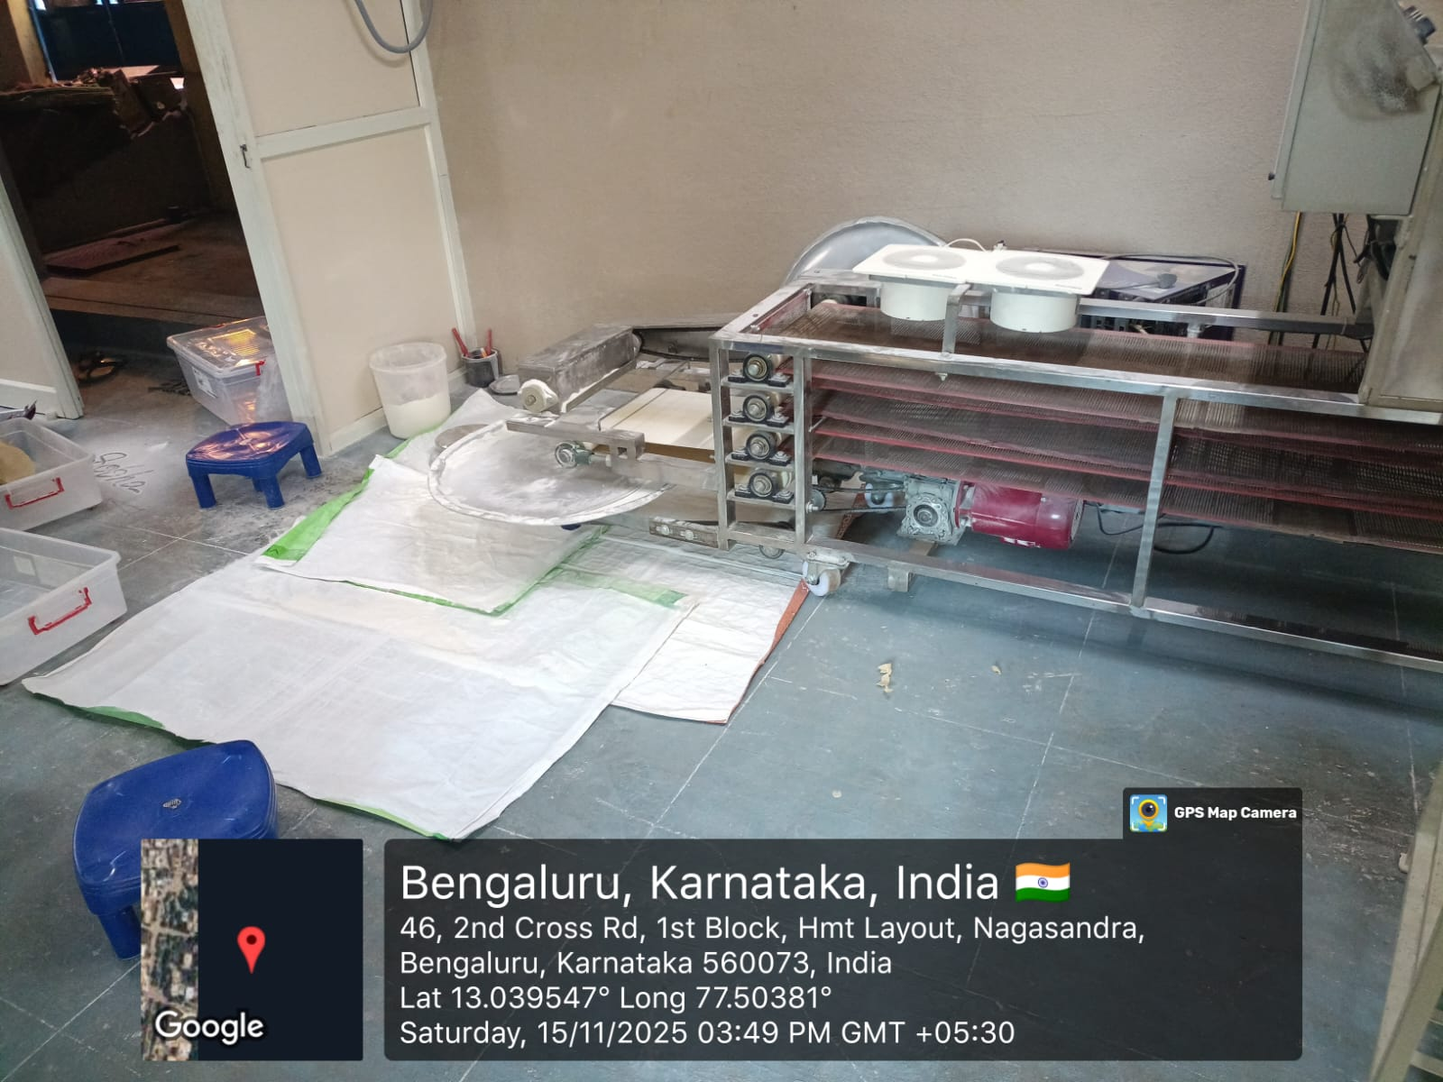
GEOTAGGED PHOTO

Slide 5
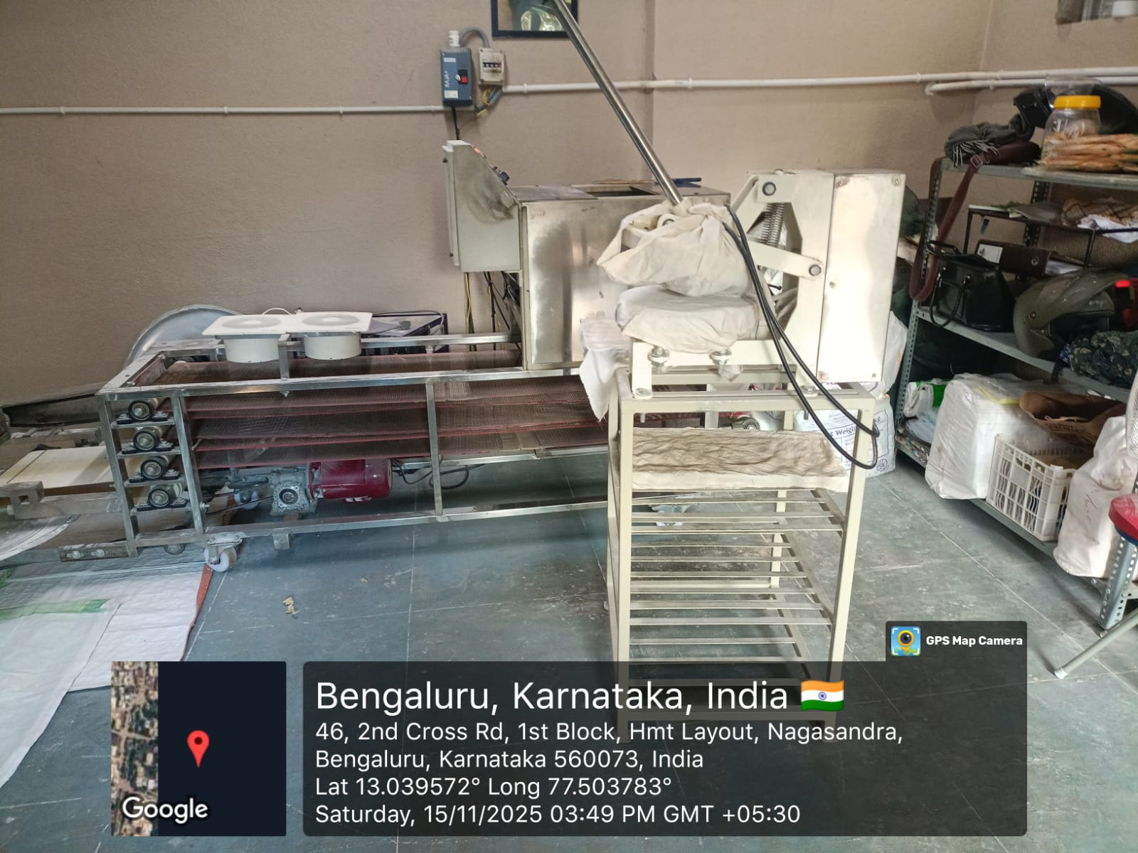
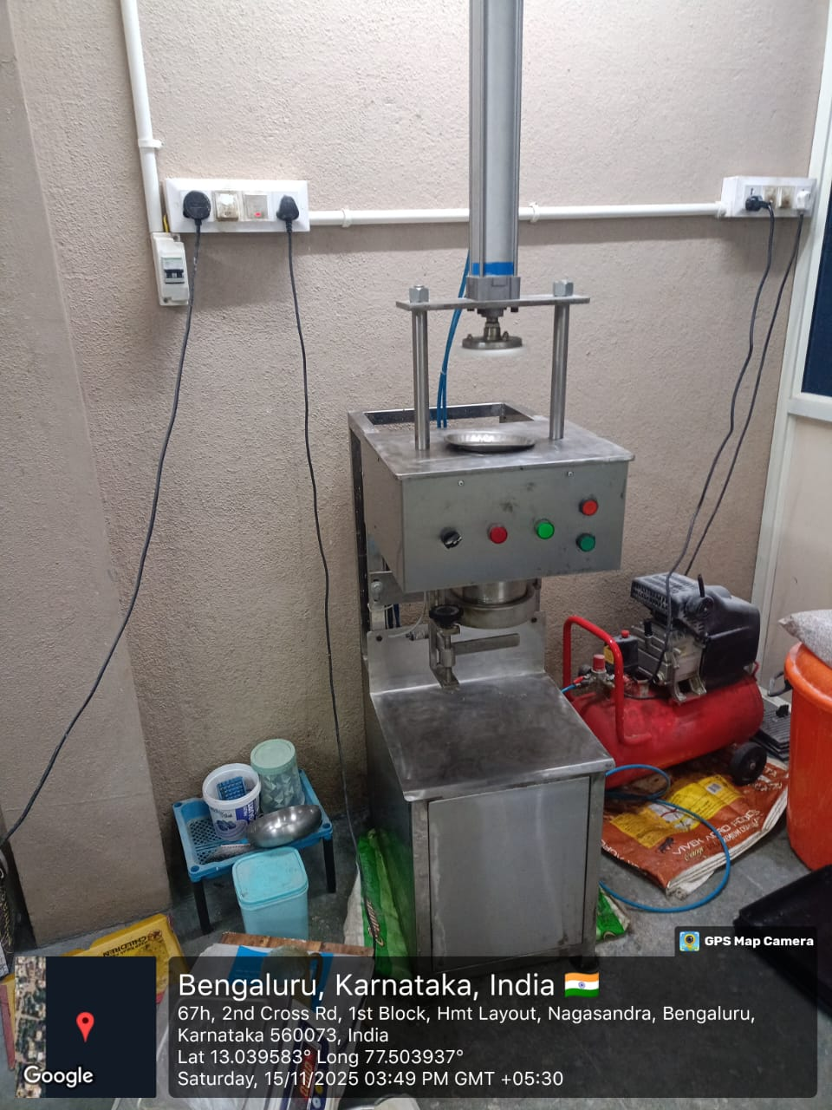
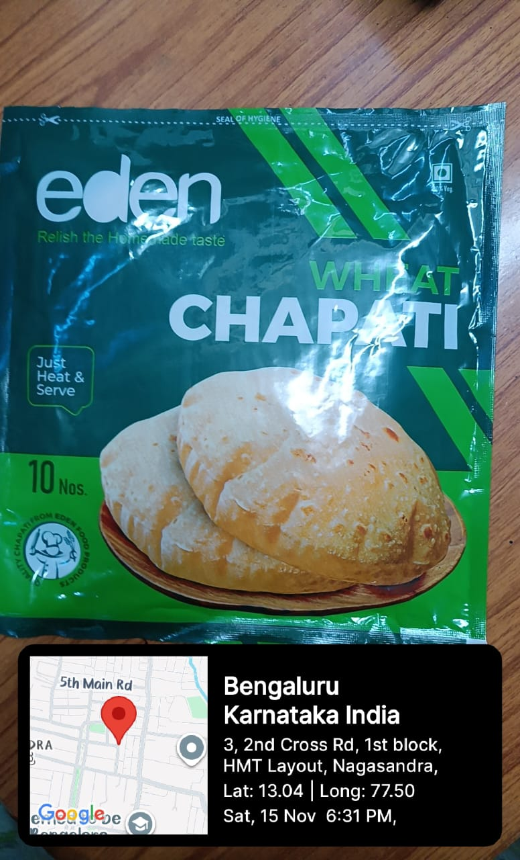
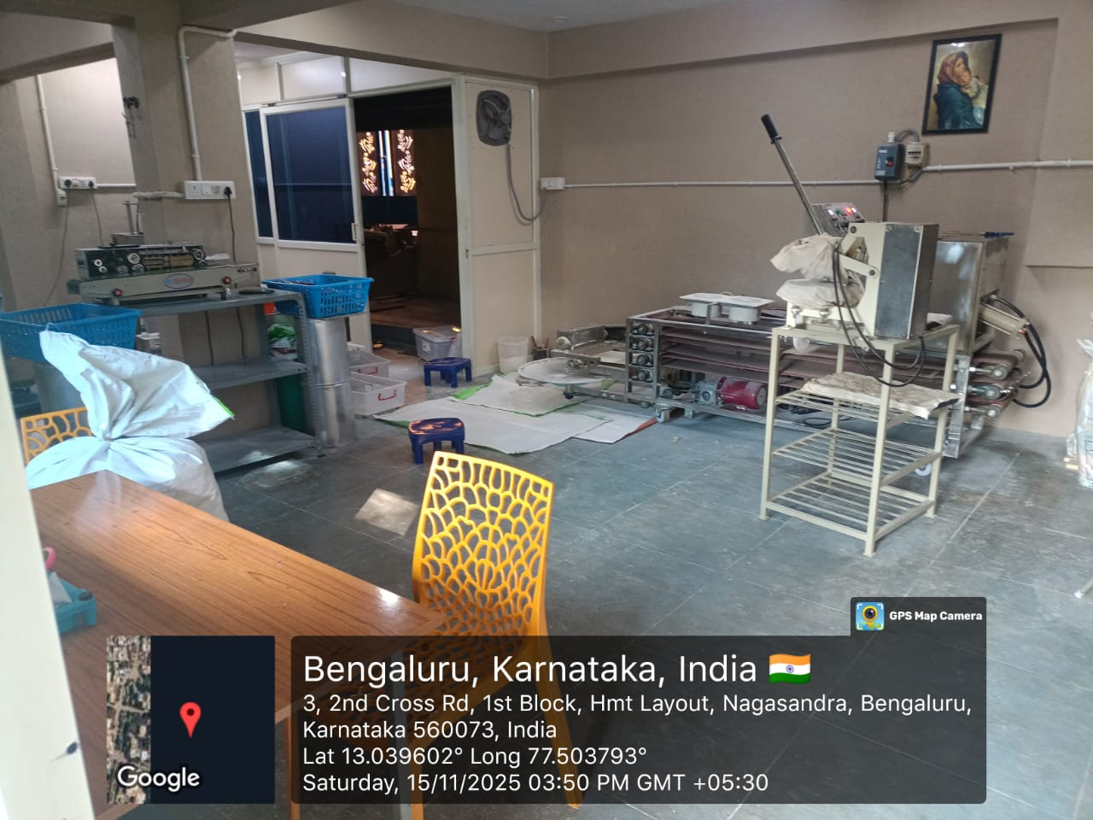

Slide 6
PROBLEM STATEMENT
Eden Food Products needed a modern website to digitally showcase their fresh items like Chapatti, Poori, Parotta, and Idli/Dosa Batter. Their ordering and delivery processes were mostly manual, limiting customer reach and efficiency. A responsive full-stack web based solution was required to improve accessibility and user experience

Slide 7
SDG GOALS
SDG 5 – Gender Equality
Empowers women-led enterprises by providing digital tools that enhance operational efficiency and business visibility. Supports equitable participation by strengthening the capacity of women entrepreneurs, enabling sustainable economic independence and competitive market presence.
SDG 9 – Industry, Innovation & Infrastructure Advances digital innovation by designing a modern web-based system using React, Tailwind, and Express.js to streamline product management, orders, and customer interaction. Strengthens technological infrastructure for small businesses, enabling data-driven operations and fostering long-term digital transformation.
SDG 8 – Decent Work and Economic Growth
Promotes inclusive economic opportunities by developing a scalable digital platform for a small business, improving productivity and operational workflow. Facilitates sustainable job creation through technology adoption and enhances entrepreneurial growth in local communities.

Slide 8
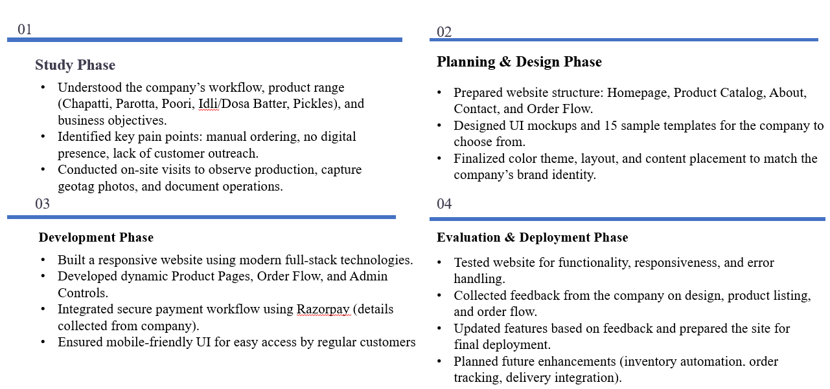
Methodology (Design & Evaluation)

Slide 9
Implementation Progress
Customer Website Fully Designed & Developed
Built complete frontend using React, HTML5, CSS, Tailwind.
Added product items, categories (menus), cart, bulk orders & subscription modules.
Payment options: COD + Razorpay placeholder.
Implemented delivery area checker using geolocation (50 km radius).
Added customer reviews, FAQ, owner details & WhatsApp chat widget integration.
Customer Website Fully Designed & Developed
Built complete frontend using React, HTML5, CSS, Tailwind.
Added product items, categories (menus), cart, bulk orders & subscription modules.
Payment options: COD + Razorpay placeholder.
Implemented delivery area checker using geolocation (50 km radius).
Added customer reviews, FAQ, owner details & WhatsApp chat widget integration.
Customer Website Fully Designed & Developed
Built complete frontend using React, HTML5, CSS, Tailwind.
Added product items, categories (menus), cart, bulk orders & subscription modules.
Payment options: COD + Razorpay placeholder.
Implemented delivery area checker using geolocation (50 km radius).
Added customer reviews, FAQ, owner details & WhatsApp chat widget integration.

Slide 10
Implementation Progress
Delivery Check & Geo-Logic Implementation
Integrated OpenStreetMap Nominatim API for address → coordinates.
Used Haversine formula to calculate distance from the company to user.
Automatically validates if delivery is allowed (< 50 km).
Provides real-time delivery availability to users during checkout.
Ready for Payment Integration & Deployment
Planned full Razorpay payment gateway integration (test mode + live mode).
Pre-configured backend routes for online payment processing.
Preparing for deployment on hosting platforms (Netlify + Render / AWS).
Next steps include linking domain, improving UI polish & final testing.

Slide 11
Weekly Report Summary
Odd Semester
• Identifying and shortlisting service-learning companies. • Contacting companies via calls, emails, and field visits. • Exploring work environments and finalizing Eden Food Products. • Requirement analysis and project concept finalization. • UI development using Tailwind CSS & React. • Building product and cart functionality. • Starting backend development (Node.js/Express API routes). • Designing the admin dashboard structure.
Even Semester
• Developing admin dashboard UI and integrating backend APIs. • Adding login authentication and linking admin features. • Testing complete order workflow end-to-end. • Improving UI responsiveness, animations & user experience. • Preparing final documentation, screenshots, and workflow diagrams. • Final testing, bug fixing, cross-device checks. • Deployment readiness and submission preparation.

Slide 12
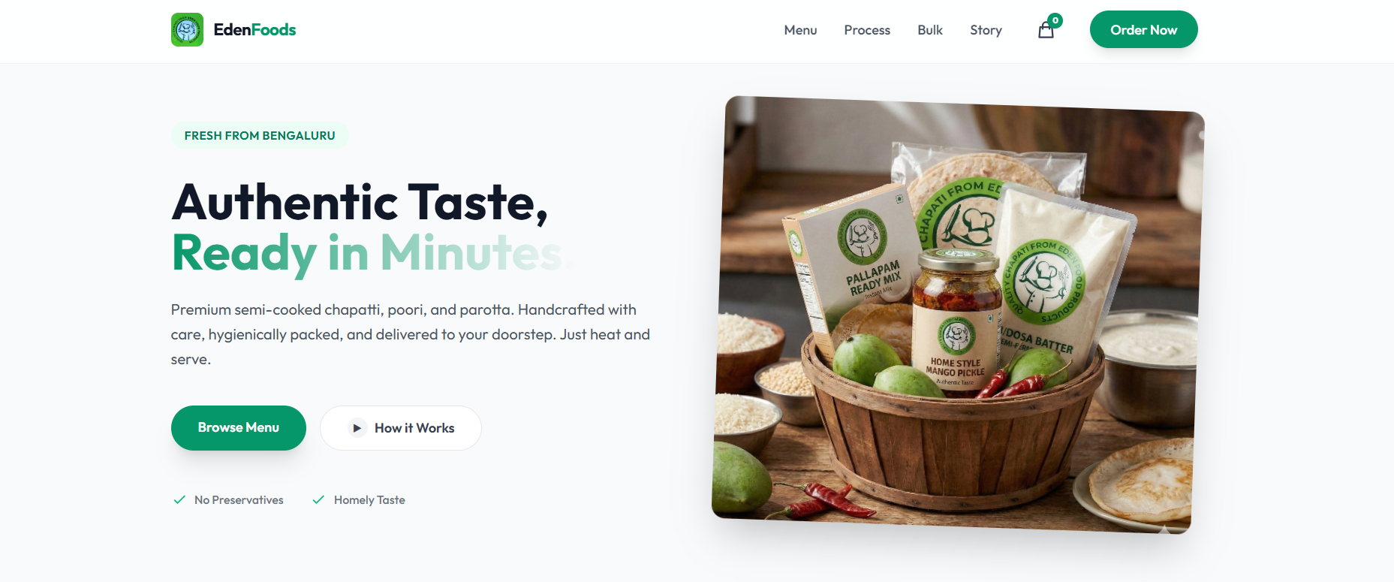
Screenshots

Slide 13
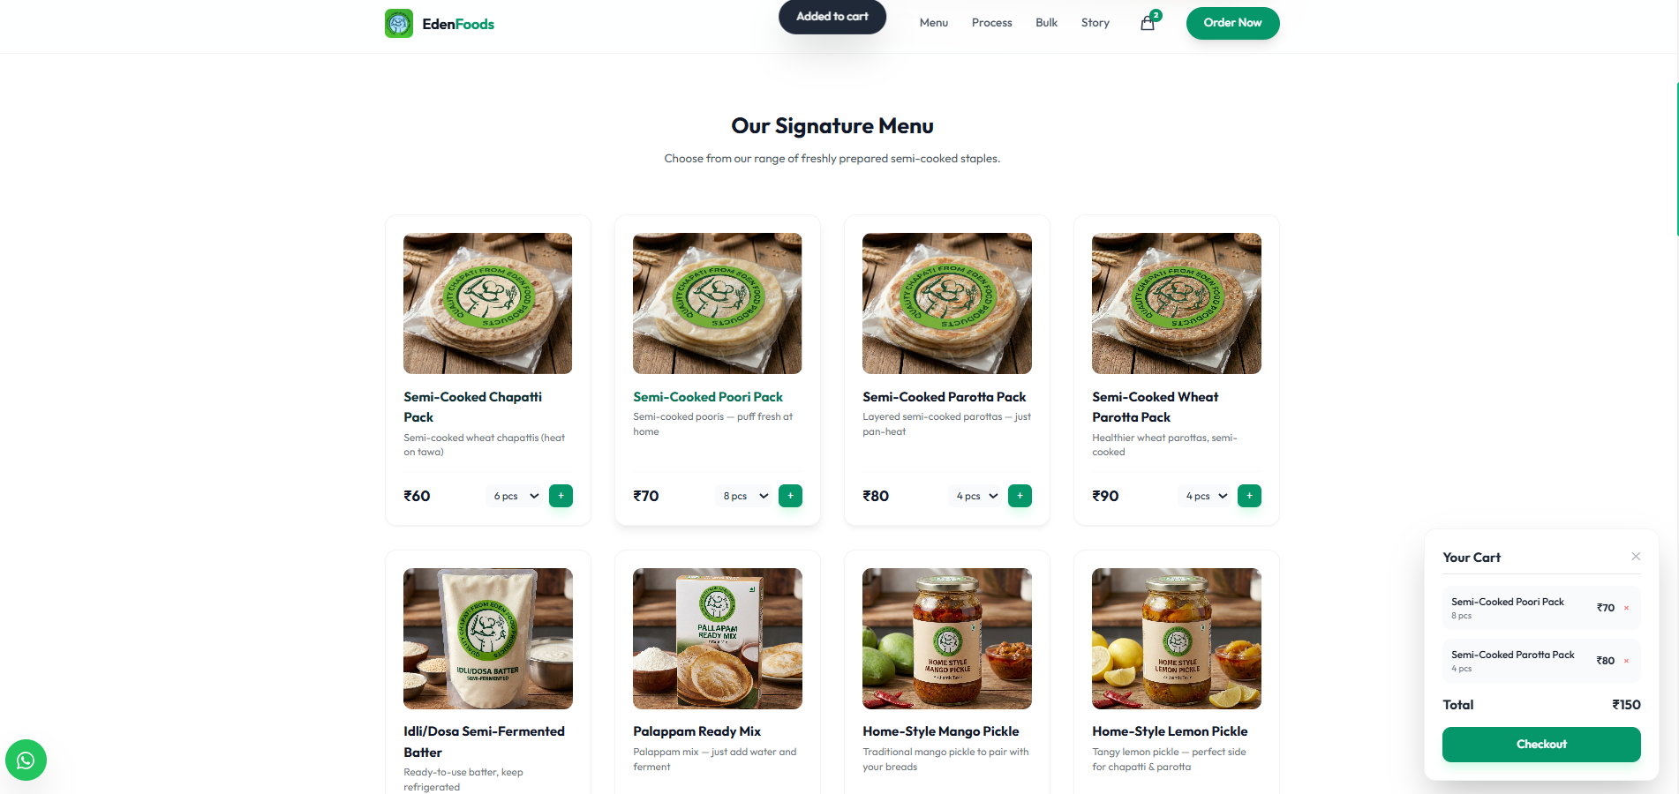

Slide 14
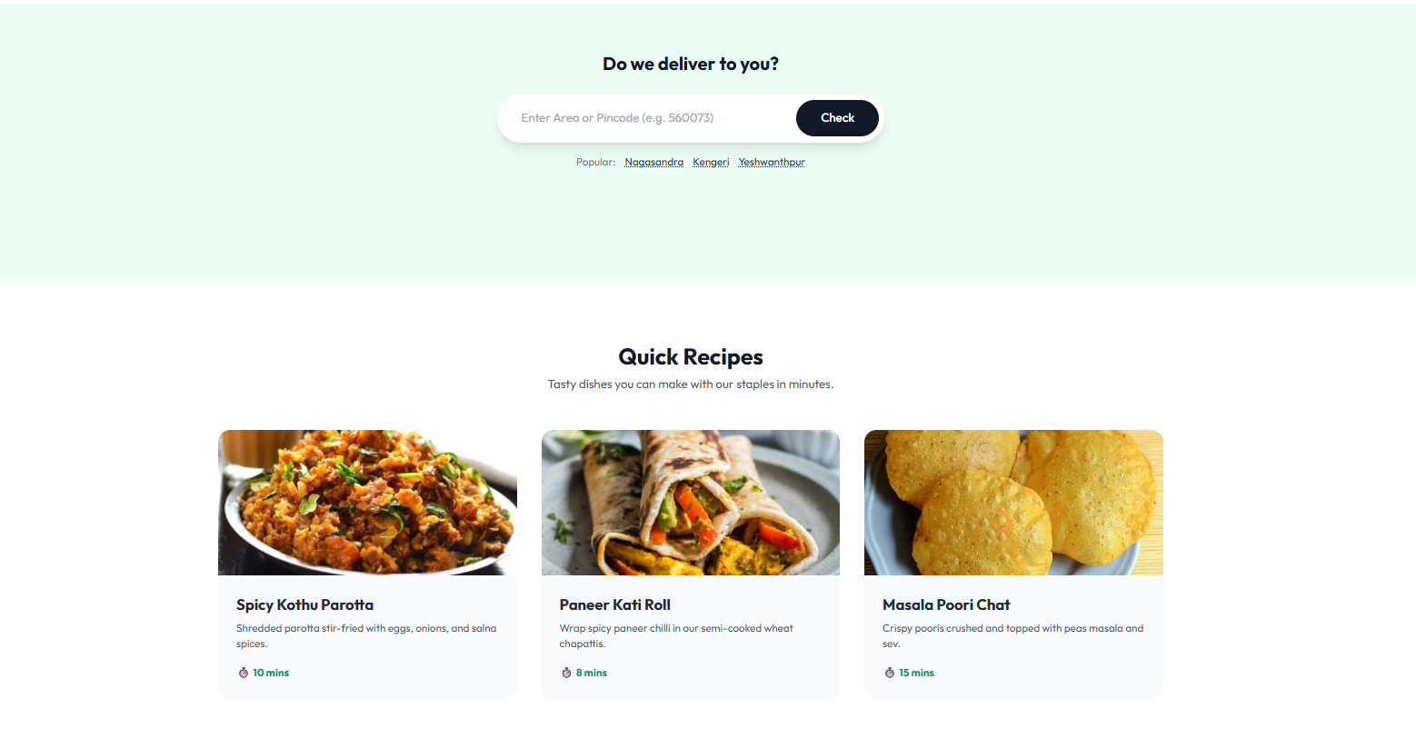
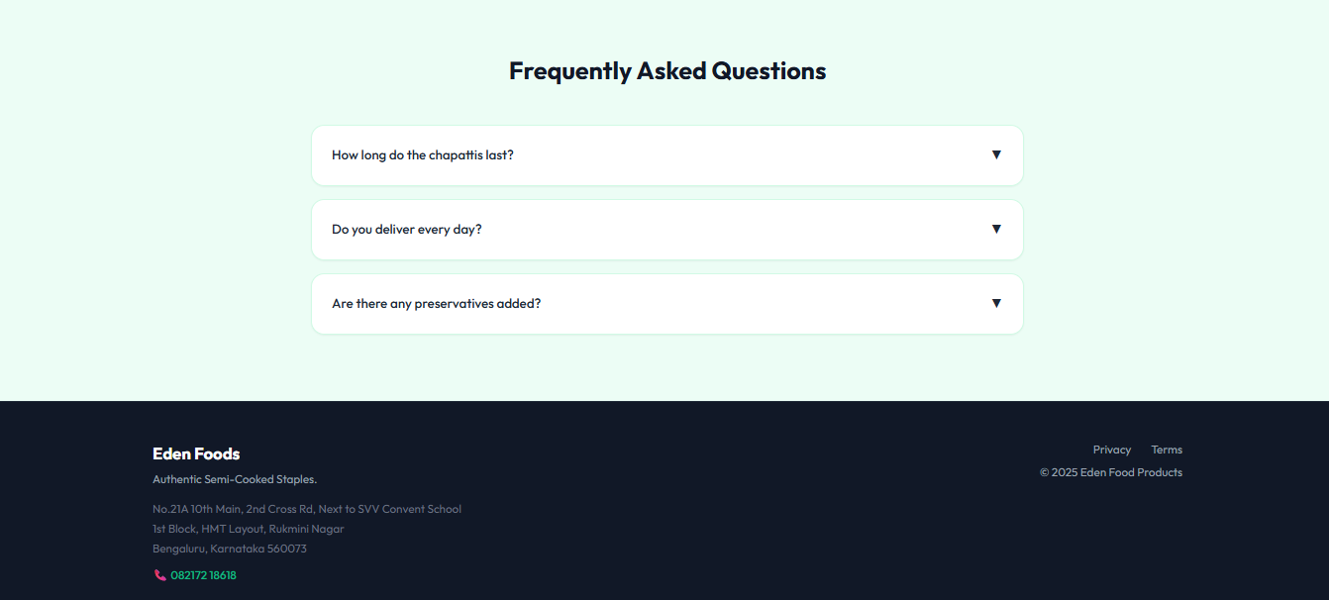

Slide 15
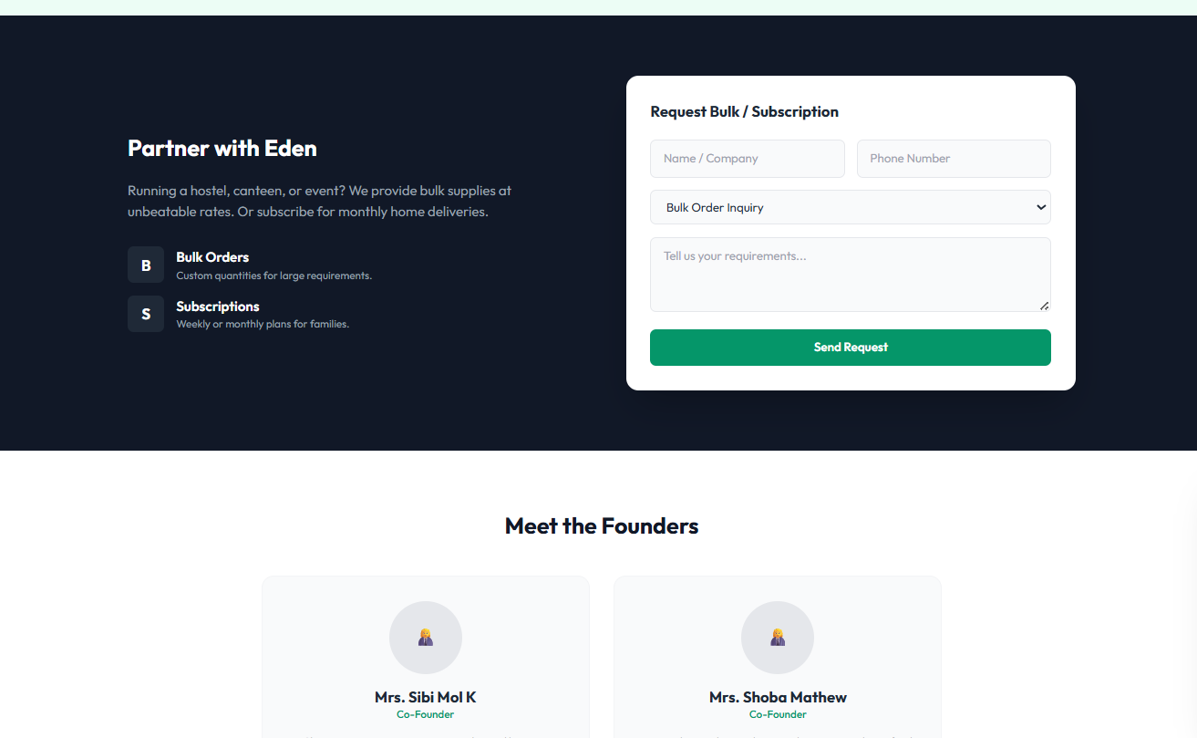
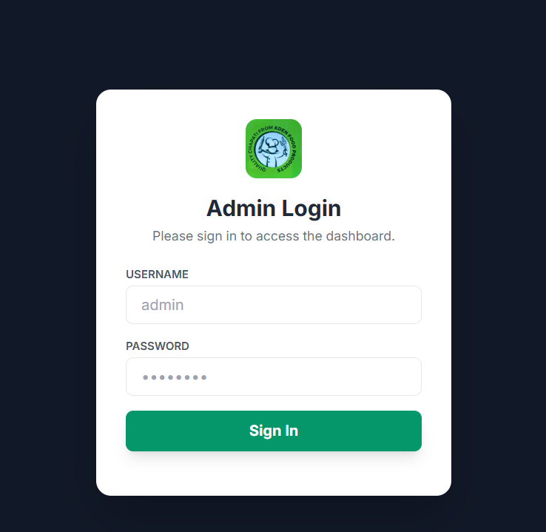

Slide 16
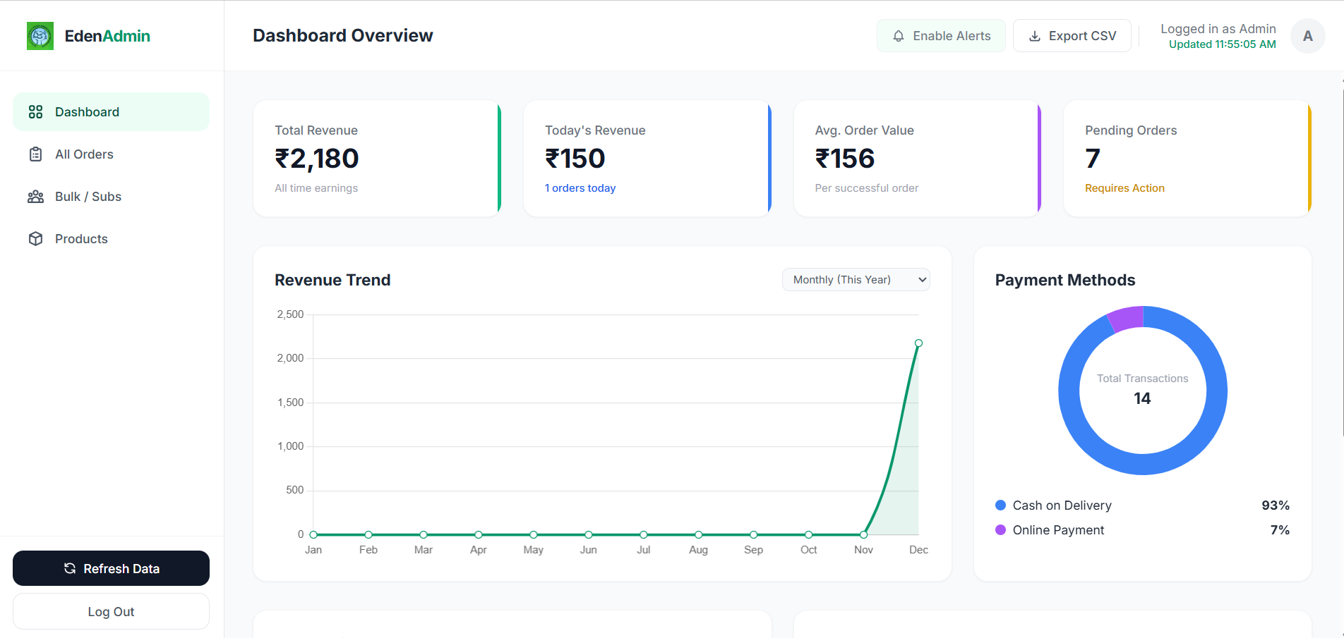

Slide 17
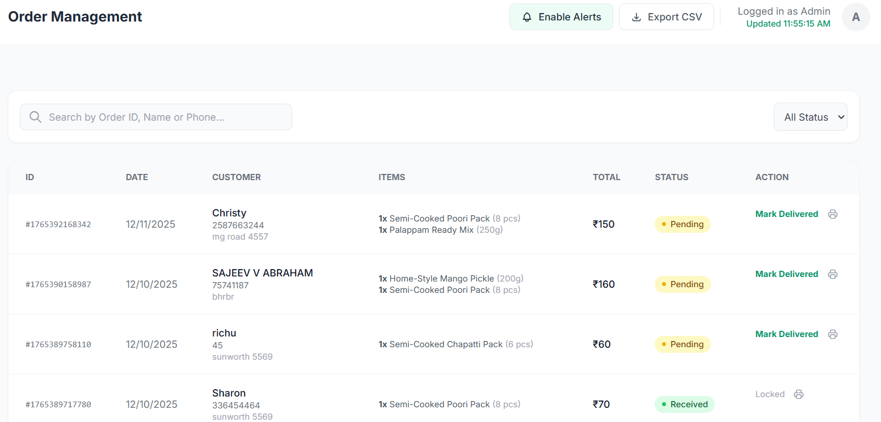

Slide 18
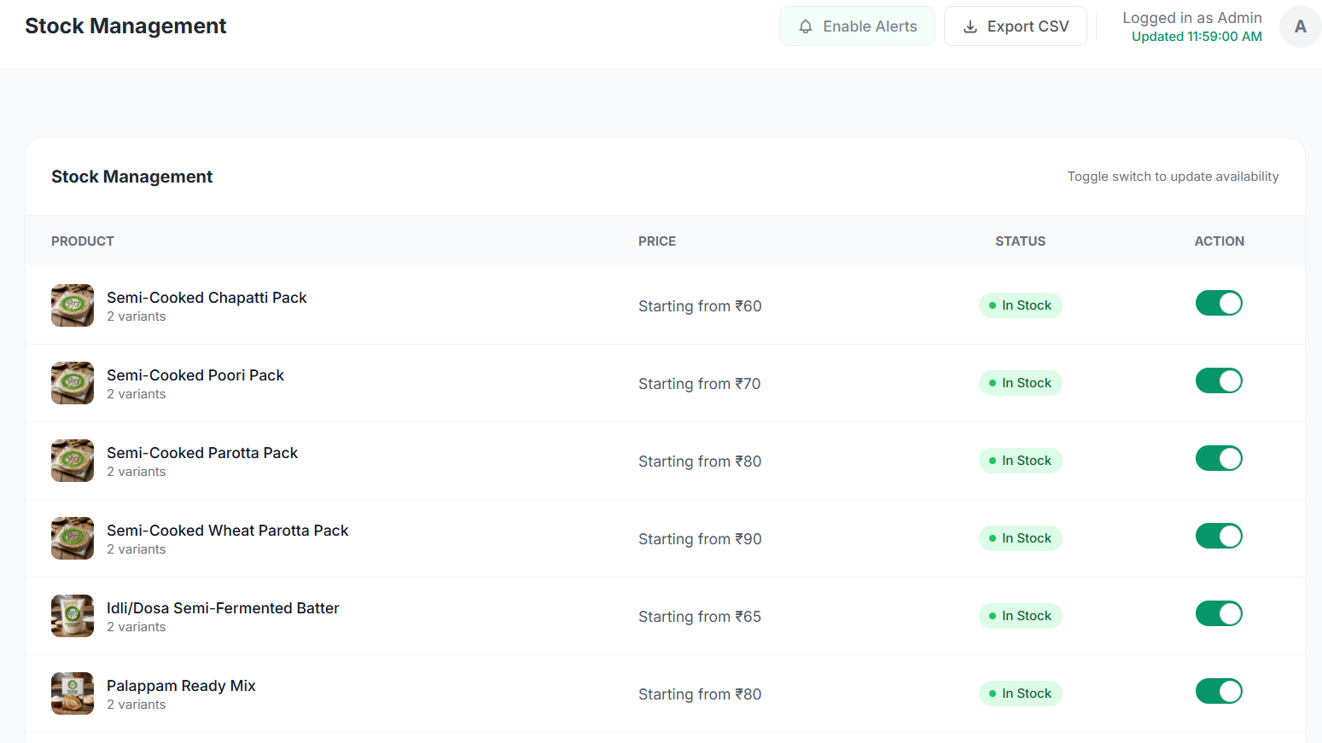

Slide 19
Conclusion
• Successfully developed a fully functional web application for a women-led small business, integrating product listings, cart features, order management, and admin workflows.
• Demonstrated strong technical competency by building and connecting React-based UI components with Express.js backend APIs, ensuring seamless system performance.
• Enhanced system usability through continuous testing, debugging, responsiveness improvements, and cross-device validation.
• Achieved service-learning objectives by applying technical skills to support community development, improve operational efficiency, and strengthen local entrepreneurship.
• Showcased effective teamwork, structured documentation, and iterative refinement, resulting in a deployment-ready system aligned with academic and community expectations.

